Slide 1
Interactive Data Exploration with Smart Drill-Down
Manas Joglekar
Hector Garcia-Molina
Aditya Parameswaran

Slide 2
Overview
Problem Setting and Motivation
Algorithm
System Architecture
Experiments

Slide 3
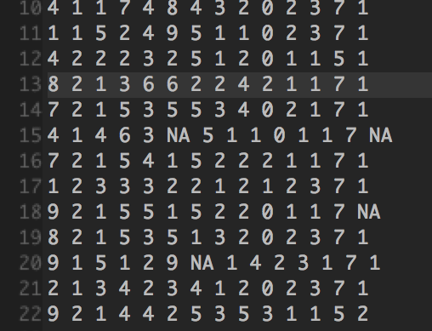
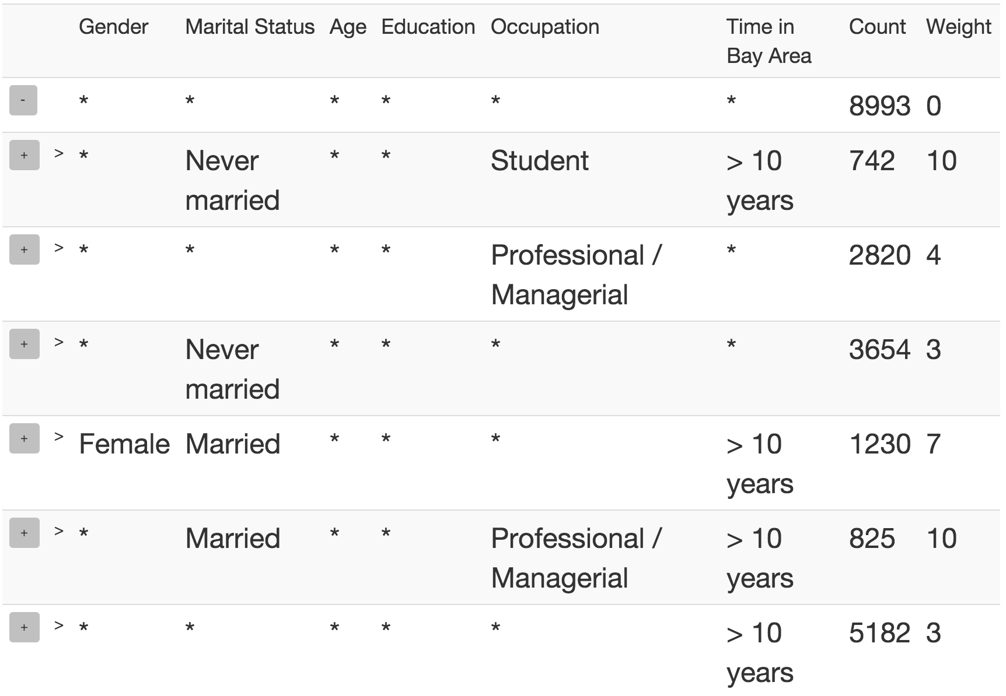
Motivation
Survey of marketing users
Hard to extract insights
Most interesting frequent `patterns’

Slide 4
Drill-Down Example (?)

Slide 5
OLAP Drill-Down
Explore relational Databases
Drill Down/ Roll Up
$10 Billion market
Limitations
Too many values
Single column

Slide 6
Smart Drill-Down
Present k most interesting patterns
Find interesting portions faster
User tunable
Interactive
Instantiate multiple columns
Complementary functionality!
Notes:
User specified number of examples
Tunable Interestingess

Slide 7
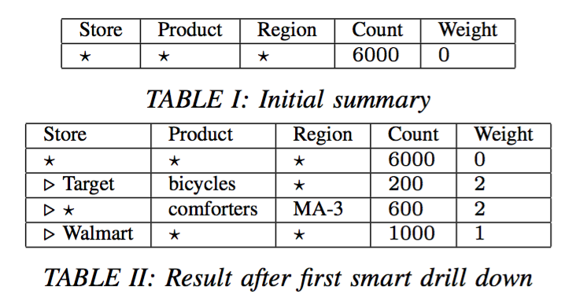
Example

Slide 8
Example
Notes:
Expand into list of 3 rules.

Slide 9
Example

Slide 10
Example summary
Display best list of k (= 3) rules
Preference for
Higher Count
Higher Weight
Low overlap
Notes:
Formalized later

Slide 11
Example summary
Display best list of k (= 3) rules
Preference for
Higher Count
Higher Weight
Low overlap
We now formalize the above notions
Notes:
Formalized later

Slide 12
Definitions
Rule: Tuple of values and *’s
Rule-List: Ordered list of rules
Count: Number of tuples satisfying rule
MCount: In a list, number of tuples not matched before

Slide 13
Definitions (cont’d)
Subrule: Strictly more specific rule
e.g. (a,b,*) is a subrule of (a,*,*)
Weight: User-defined interestingess measure
Maps rule to a non-negative real number
Must be monotone
Rule-List: Ordered list of rules

Slide 14
Definitions (cont’d)
Subrule: Strictly more specific rule
e.g. (a,b,*) is a subrule of (a,*,*)
Weight: User-defined interestingess measure
Maps rule to a non-negative real number
Must be monotone
Rule-List: Ordered list of rules
Score:

Slide 15
Formal Problem
Problem 1: Given a table T , a monotonic weighting function W, and a number k, find the list R of k rules that maximizes

Slide 16
Weight functions
Intrinsic interestingness of rule
Examples
Size : Number of non-star values
Bits : Number of bits needed to specify non-star values
Bits favors columns with more distinct values
Notes:
User tunable. Only two restrictions

Slide 17
Overview
Problem Setting and Motivation
Algorithm
System Architecture
Experiments

Slide 18
High level Algorithm
Theorem: Let R, R’ be rule-lists with same set of rules, where rules in R are sorted by weight (decreasing). Then

Slide 19
High level Algorithm
Theorem: Let R, R’ be rule-lists with same set of rules, where rules in R are sorted by weight (decreasing). Then
Thus, always sort rules by weight!
Find best set rather than list.
Still NP-Hard

Slide 20
Submodularity
Define
where S is rule-set, R is weight-sorted rule-list
Then Score is submodular

Slide 21
Submodularity
Define
where S is rule-set, R is weight-sorted rule-list
Then Score is submodular
Theorem: The greedy algorithm achieves a
approximation

Slide 22
High level Algorithm

Slide 23
Finding the best marginal rule
Brute-force: Compute marginal value for all rules?
Too expensive

Slide 24
Finding the best marginal rule
Brute-force: Compute marginal value for all rules?
Too expensive
Key Insight
If R₂ is sub-rule of R₁,

Slide 25
Finding the best marginal rule
Brute-force: Compute marginal value for all rules?
Too expensive
Max Weight Parameter m_{w}
A Priori-like algorithm
Evaluate all size 1, then 2, and so on
Only evaluate higher size rules that have a chance of being the best

Slide 26
Overview
Problem Setting and Motivation
Algorithm
System Architecture
Experiments

Slide 27
Scaling to large datasets
Run-time linear in table size
Doesn’t scale to millions of tuples
Slow if tuples not in main memory

Slide 28
Scaling to large datasets
Run-time linear in table size
Doesn’t scale to millions of tuples
Slow if tuples not in main memory
Solution: Sampling!
Predict clicks and maintain samples

Slide 29
Scaling to large datasets
Sample Handler:
Predicts clicks and maintain samples
Subject to two user specified constraints
minSS : Minimum sample size to compute rule-list
M : Available memory

Slide 30
Scaling to large datasets
Sample Handler:
Predicts clicks and maintain samples
Subject to two user specified constraints
minSS : Minimum sample size to compute rule-list
M : Available memory
Optimal sample allocation: NP-Hard
DP approximation

Slide 31
System Architecture

Slide 32
Overview
Problem Setting and Motivation
Algorithm
System Architecture
Experiments

Slide 33
Experiments
Datasets
Marketing Survey
Census
Studies
Qualitative
Quantitative

Slide 34
Size weighting

Slide 35
Bits weighting

Slide 36
Running time vs. mw

Slide 37
Running time vs. minSS

Slide 38
Count error vs. minSS

Slide 39
Rule error vs. minSS

Slide 40
Conclusion
Smart Drill-Down augments and generalizes regular Drill-Down
Helps find interesting portions of a table fast
Interactive
Tunable
Fast with no preprocessing

Slide 41
Thank You!!
Questions?

